Slide 1
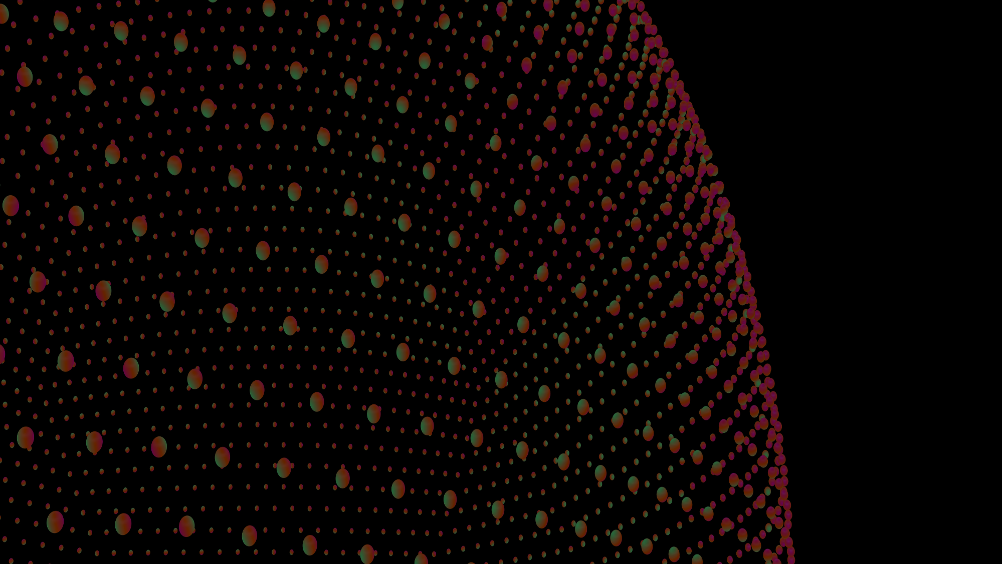
CT7204 ETHICAL DATA SCIENCE IDENTIFICATION OF INTERNET DEEPFAKES FROM REAL PEOPLE USING AI
ETHICAL ISSUES RELATING TO DEEP FAKES FOR IMPERSONATING PUBLIC FIGURES TO CREATE FAKE NEWS
By:
THULASEEDHARAN SABARINATH (s4201403)
OLUWATOYIN ODENIYI (s4115181)
GEORGE SANDRA (s4201146)

Slide 2
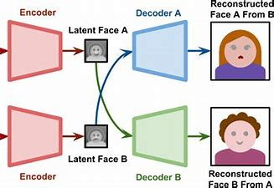
WHAT ARE DEEPFAKES?
Deepfakes are hyper-realistic videos manipulated to make it seem that people are saying and doing things that never happened. Deepfake is a combination of the words: deep learning and fake (Mika Westerlund,2019). It is a technology with which face images can be superimposed on a target person in a video or picture, making them say and do what they never did.
Deepfakes are produced using Artificial Intelligence (AI) applications. An AI algorithm called an Encoder network finds similarities between features. A second AI Algorithm called Decoder network, recovers a face from compressed images.

Slide 3
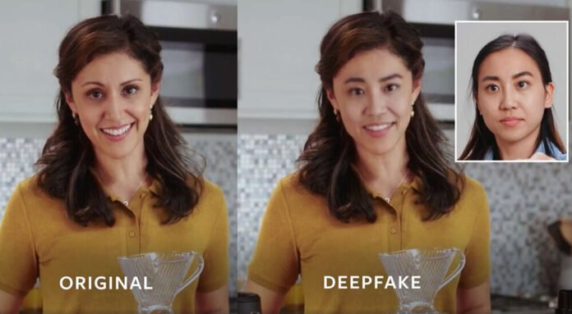
Ethical Implications of Deepfakes in relation to the given Dataset
Ethical implications of deepfakes include: copyright infringement, right of publicity, revenge pornography. An example of revenge porn is the Rana Ayyub case where her face was superimposed on bodies of naked women and shared online (National Herald, 2018). Right of Publicity poses two questions: Was consent of the people whose faces were to be swapped, sought, like in the image on the right? Did the person understand the risk of face swapping to be able to make informed decisions? (Alan Zucconi, 2018). These ethical implications of deepfake datasets need to be considered by Data Scientists before Data processing. Three important questions to be addressed in this regard for this presentation:
What are the ethical factors within the given dataset?
How can Data scientists mitigate against biases while working withing relevant legislation?
How to augment the give dataset to ensure it is within legislation?

Slide 4
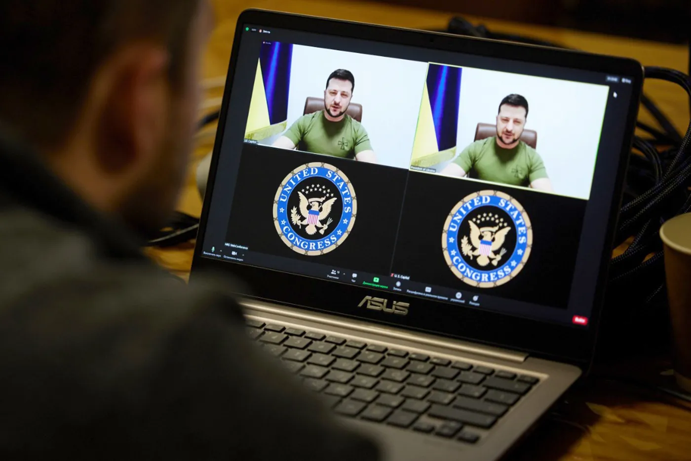
What are the Ethical factors within the given dataset? .The consent of the people whose real faces were used for the deepfake dataset: If their consent was acquired and if they understood the risks involved. . The purpose of the deepfake dataset should be clear and defined. If it is for non-consensual pornography, this is an ethical issue. If it could fall into the hand of potential blackmailers who could manipulate the images, this is an ethical issue or into the hands of cyber bullies, it would be an ethical issues. . Fake news could have huge harmful effects and deepfake technology has been used to spread damaging misinformation. This is an ethical issue as seen in a recent video of the Ukrainian President, Volodymyr Zeleneskyy where he was calling on Ukrainians to stop fighting Russian soldiers. In the deepfake video, his head was tilted at an angle and his body was motionless (these are some pointers of whether a video is real or a deepfake). Not long after the video was broadcast, the Ukrainian President debunked the video which has been shared on Facebook and YouTube (Jackson Cote, 2022).

Slide 5
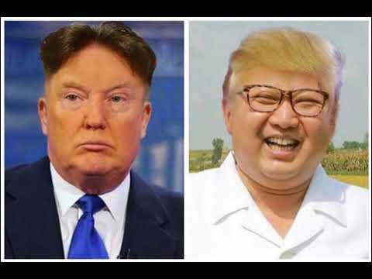

How can data scientists mitigate against biases and work within the relevant legislation?
Pictorial depiction of deepfake image where the faces of Donald trump and kim jong-un were swapped
. For data scientists to guard against biases like confirmation bias, orientation bias, sampling bias, modelling bias, ‘time will tell’ bias in datasets they are working with, they first need to be aware that biases can exist in datasets and will skew results. This means incorrect outcomes will be reached. Data scientists should ascertain the source of the datasets and if consent was obtained like for the real faces in the dataset for this assessment. There are four main types of deepfake producers: Actors and Producers, Fraudsters, Political leaders or activists, Deepfake Hobbyists (Mika Westerlund, 2019). Dataset obtained from these groups should be critically assessed before use. data scientists should only use datasets which satisfy all existing legislation guarding the use of personal data. Some of these legislations used to check the given dataset was GDPR and Copyright law.
. General Data Protection Regulation (GDPR) is a legislation which data scientists must use as a guide when collecting personal data of people for a dataset. The GDPR also protects the personal data of people using deepfake technology-based apps like TikTok and FaceApp. A Data Protection Impact Assessment (DPIA) should be done for the creation of deepfake datasets like the one for this assessment. Another legislation is Copyright law which gives the owner of the image, exclusive rights on what it can be USED for. The image of trump In the picture on the left, was most likely used without his consent and as it is his image, it goes against the gdpr legislation if that legislation is applicable to the source country where the deepfake image was created.

Slide 6

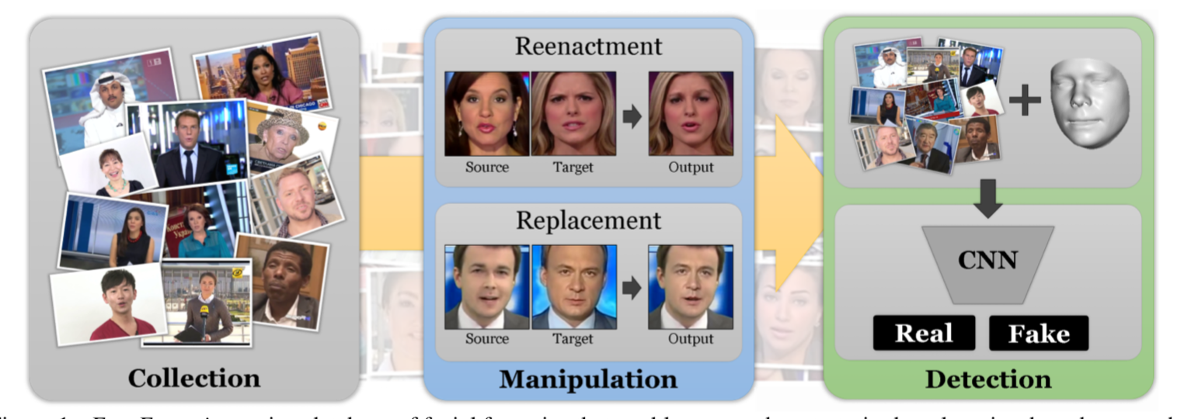
? How to augment the given dataset to ensure it is within the relevant legislation? .To design future data-gathering to augment datasets (artificially increasing the size of the dataset to get more data) like the one given, while ensuring everything is done within legislation, data scientists can manipulate images by flipping or shifting. Image data augmentation should be done on the training dataset as that should be the focus of the model. . Legislation like image right and copy right should be a guide when augmenting deepfake dataset like this one. The permission to augment the dataset should be obtained first (Jason Brownlee, 2019), to avoid litigation regarding copyright law.

Slide 7
CONCLUSION While there have been instances where deepfakes have been used in disturbing, negative ways like revenge porn, blackmail, voice fraud, in 2018, this technology has been used for recreating Holocaust survivors in the Illinois Holocaust Museum and Education Centre in USA. Visitors were able to interact and ask questions in hologrammatic interviews, which was good for preserving history for younger generations. David Beckham’s Malaria Must Die Campaign where he spoke in nine different languages. This means more people around the world understood what the message was about which was effective communication as this technology in an effective tool to overcome language barrier (ThinkAutomation, 2021). However, considering how far reaching the negative uses of deepfake technology is, it would be a good approach for public awareness to be created on how to spot deepfakes. Schools and communities can benefit from training programs on how to spot deepfakes in print and social media. These training programs can be organized by relevant stakeholders and Governments in collaboration with Researchers and Data scientists. An an example, there can be stiffer punishments for offenders who disobey laws regarding copyright infringement and voyeurism act for which offenders can face up to two years imprisonment for taking digital images or videos under a person’s clothing without permission (Elizabeth Hurst, 2019). Considering how fast technology is developing, it is therefore imperative that legislation with stiffer punishments needs to be implemented. More social media companies like Facebook, YouTube, Twitter should take front seat strategies to create or sponsor readily available technology which can combat the negative use of deepfake technology since they have the biggest platforms which some people with malicious intent have used to spread fake news and misinformation about people and nations. Groups like The Organization for Social Media Safety is supporting media training in public schools to teach children how they can take a non-partisan approach in evaluating and understanding the authenticity of content online (Jackson Cote, 2022). People should make the decision to become responsible in tackling the negative use of technology like Deepfakes as it can cause harmful, ripple effects with far-reaching consequences.

Slide 8
REFERENCES
references
Ayyub, R., 2018. https://www.huffpost.com/archive/in/entry/deepfake-porn_a_23595592. [Online].
Zucconi, A., 2018. https://www.alanzucconi.com/2018/03/14/the-ethics-of-deepfakes/. [Online].
Nguyen, T.T., 2019. Deep Learning for Deepfakes Creation and Detection: A Survey
Cote, J.,2022.Deepfakes and Fake News Pose a Growing Threat to Democracy – News @ Northeastern. [Online].
Westerlund, M.,2019. The Emergence of Deepfake Technology: A Review. Technology Innovation Management Review, 9(11)
ThinkAutomation,2021. https://www.thinkautomation.com/bots-and-ai/yes-positive-deepfake-examples-
Hurst, e., 2019. https://www.allaboutlaw.co.uk/commercial-awareness/legal-spotlight/how-can-deal-with-deepfake-

